Slide 1
INVESTMATE

Slide 2
AGENDA
new/updates (check the bottom of the slide)
Team Members
Improvements
Problem Statement
Project Description
Market Analysis
Team Agreement
Personas
MVP
Tech Stack
Algorithms
Diagrams
User Acceptance criteria
Sprint Schedule
Test Cases
Metrics
Retrospective
Wiki Link

Slide 3






MEET OUR TEAM
Venkatesh Nidumukkala
Ankit Mhatre
Mani Chandana Kilaru
Backend Developer
Project Manager / ML Engineer
Front End Developer
Tejaswi Koppula
Uma Maheshwari Bichinepally
Charan Raju m
Backend Developer
UI/UX Developer
Tester

Slide 4
IMPROVEMENTS FROM FEEDBACK
Team Agreement
Diagrams
Recap for sprints
Added Test Cases
Added Completed/Committed ratio
Future Sprint details in tabular format
Better format for Retrospective
Added Missing Link

Slide 5
PROBLEM STATEMENT
In the contemporary world of finance, a considerable number of young individuals aged 18 to 25 are perplexed by the dilemma of pursuing a career in this global trend, while experiencing various challenges in finding sources of practical experience and knowledge. Despite acquiring the principles taught in academic institutions, individuals encounter difficulties implementing them in real-life scenarios. This creates a proficiency gap between their educational knowledge and investment strategies, which arises from the complexities in the structure and the fear of monetary loss, a significant factor that should be addressed in the education platform. It is imperative to develop an easily understandable education platform that adopts a learner-based approach to bridge this gap.

Slide 6
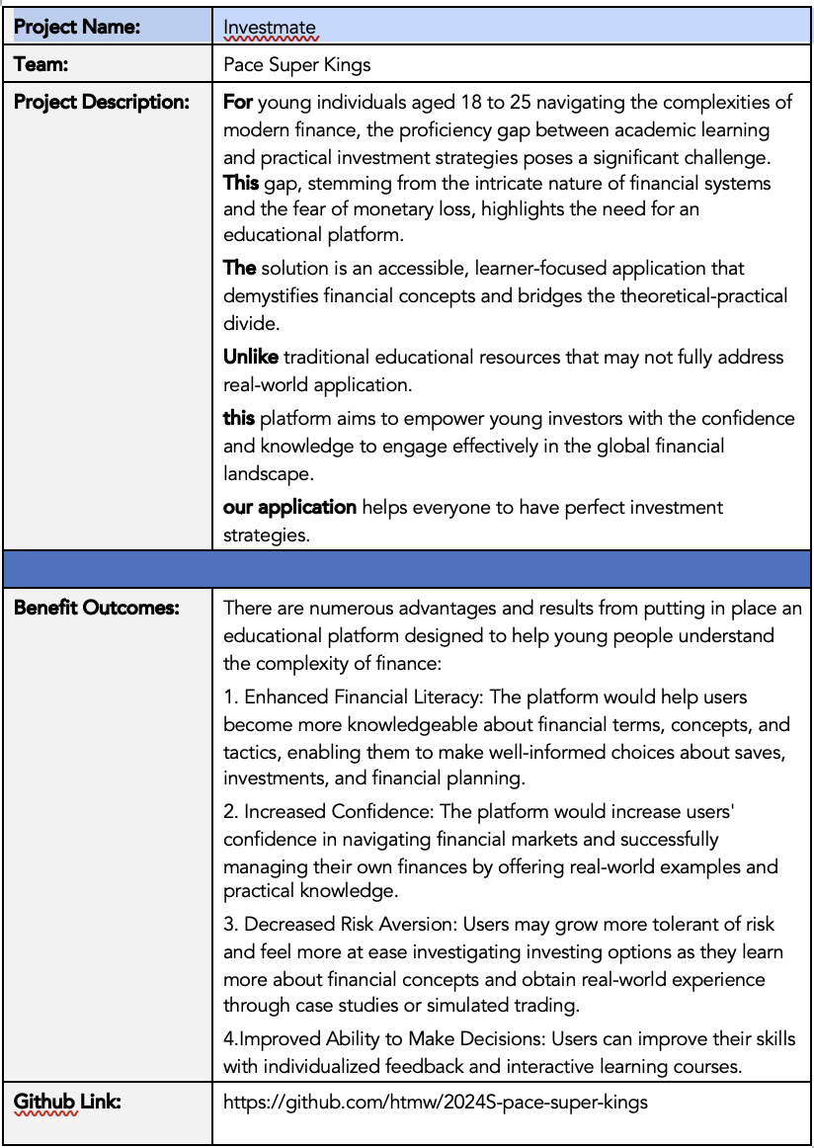
PROBLEM
DESCRIPTION

Slide 7
MARKET ANALYSIS
The online investment platform market is aggressively rising at a CAGR of 14.4% to $4.4 billion by the year 2028 due to AI's introduction and the popularity of digital investment. The main variables are the incorporation and application of AI algorithms for data analysis and risk management, increasing investments that are a direct result of economic growth, and the increase of high-net-worth individuals (HNWIs) in digital assets. Disadvantages such as complex regulatory requirements may stop penetration into new markets. In the development process, the market is subject to the influence of the spread of blockchain technology and, to a great extent, the COVID-19 pandemic, which was considered the catalyst for the increased volume of investments via digital platforms.

Slide 8
TEAM AGREEMENT
Each team member shall actively listen to and consider one another's opinions and perspectives, fostering an environment of open communication and constructive feedback. We will engage in respectful dialogue, valuing diverse viewpoints.
Decisions regarding project workflow will be made collectively through discussions and deliberations. We will ensure that all voices are heard, and the majority opinion will guide our actions, promoting a sense of ownership and commitment to the project.
We are committed to upholding the highest standards of professionalism at all times. Inappropriate behavior, such as disrespect, discrimination, or harassment, is strictly prohibited. Any instances of misconduct shall be promptly reported to the team leader or project supervisor for appropriate action, ensuring a safe and inclusive working environment for all team members.
Recognizing the unique strengths and expertise of each team member, we will leverage our collective talents to contribute effectively to the project. We will actively seek opportunities to collaborate, support, and assist one another, fostering a culture of mutual respect and cooperation. Through our combined efforts, we will strive for excellence in all aspects of our work.
Regular team meetings will be crucial forums for discussion, planning, and decision-making. We will actively participate in these meetings, sharing updates on our progress, addressing challenges, and brainstorming solutions collaboratively.
All team members must attend all scheduled meetings. In the event of unavoidable conflicts, timely communication and proactive efforts to reschedule or catch up on missed discussions will be prioritized, ensuring that no team member is left behind.
We are committed to meeting all assigned tasks and deadlines promptly, demonstrating reliability and accountability in our work. Should any team member encounter difficulties or require assistance, we will proactively seek help from our peers, fostering a culture of support and collaboration.
Recognizing the importance of timely completion, we understand that extensions beyond agreed deadlines will be granted with seriousness. We will prioritize effective time management and proactive communication to ensure the successful execution of our project deliverables.
Clear and transparent communication is essential for effective collaboration. We will utilize Slack as our primary communication platform, actively engaging in discussions, sharing updates, and seeking clarification when needed.
All team members are expected to participate in Slack discussions regularly, responding promptly to messages and actively contributing to the exchange of ideas. Through our collective efforts, we will maintain open lines of communication, fostering a culture of transparency and collaboration.

Slide 9
PERSONAS

Slide 10
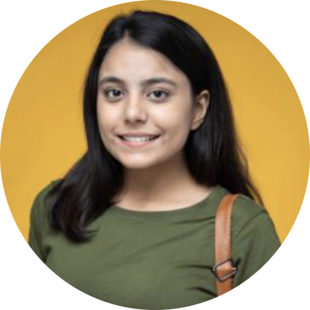
PERSONA - 1
Name: Priya
Age: 23
Occupation: College student in the final year, aspiring to start her own business.
Investment Experience: Minimal experience.
Goals: To acquire investment management skills for better financial management.
Challenges: Unable to balance academic responsibilities, entrepreneurial planning and investment learning.

Slide 11
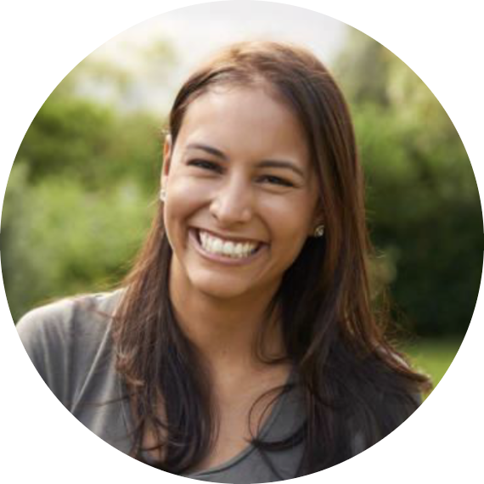
PERSONA - 2
Name: Sara
Age: 20
Occupation: College student majoring in English Literature.
Investment Experience: None.
Goals: Interested in learning about personal finance and investing to start saving for the better future
Challenges: Unable to understand the financial terms

Slide 12
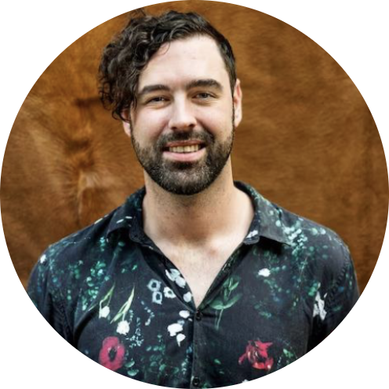
PERSONA - 3
Name: Michael
Age: 25
Occupation: College student majoring in finance.
Investment Experience: No practical experience.
Goals: To gain hands-on experience in the stock market using his classroom knowledge.
Challenges: Finds it difficult to apply his theoretical knowledge in real-world

Slide 13
MINIMAL VIABLE PRODUCT (MVP)

Slide 14
ML-driven Trading Simulations
Adaptive Risk Management Tools
Personalized Learning Paths

Slide 15





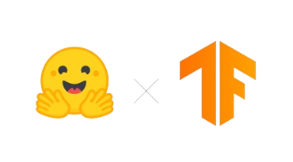


TECHNOLOGIES

Slide 16
ALGORITHMS
YOLOv8s : https://huggingface.co/foduucom/stockmarket-pattern-detection-yolov8
The YOLOv8s Stock Market Pattern Detection model is an object detection model based on the YOLO (You Only Look Once) framework. It is designed to detect various chart patterns in real-time stock market trading video data. The model aids traders and investors by automating the analysis of chart patterns, providing timely insights for informed decision-making. The model has been fine-tuned on a diverse dataset and achieved high accuracy in detecting and classifying stock market patterns in live trading scenarios.
LSTM : https://www.kaggle.com/code/faressayah/stock-market-analysis-prediction-using-lstm
Using Seaborn and Matplotlib, analyzing the risk of a stock, based on its previous performance history. Also predicting future stock prices through a Long Short Term Memory (LSTM) method.

Slide 17
DIAGRAMS

Slide 18
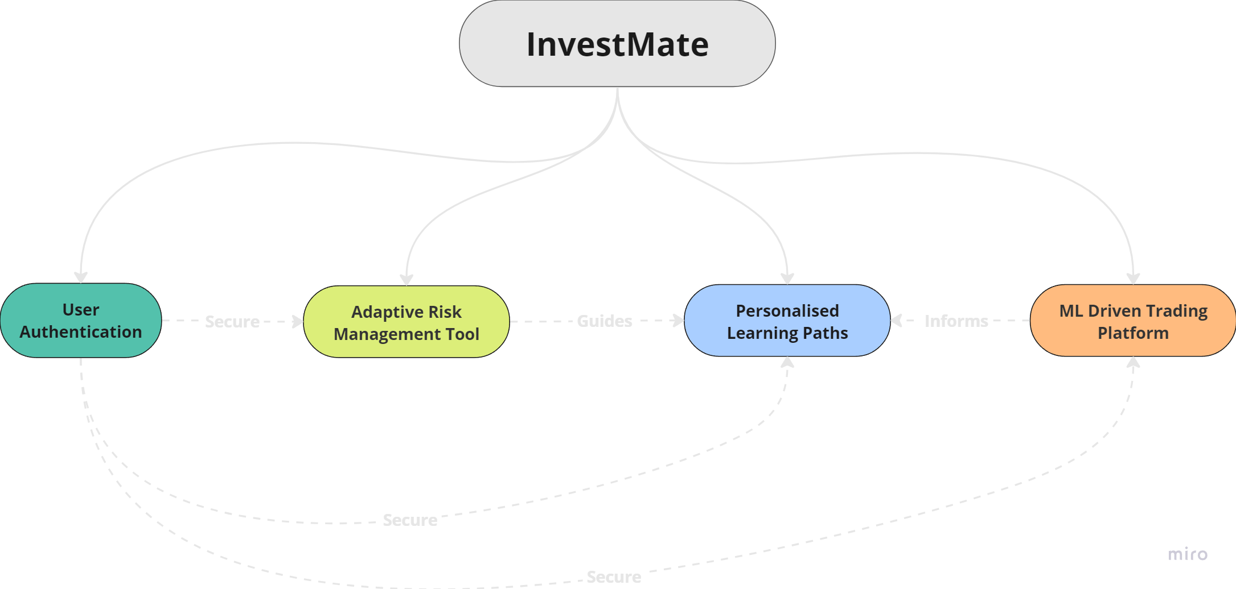
CONCEPTUAL DIAGRAM

Slide 19
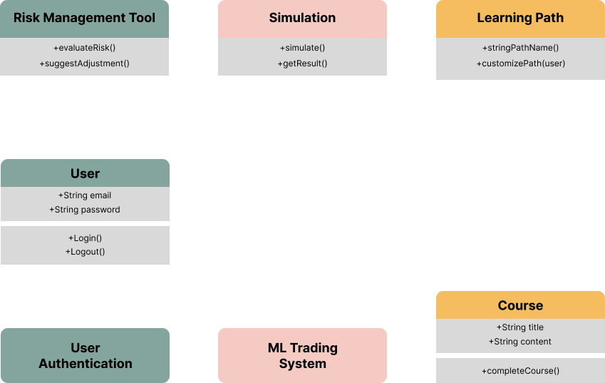
CLASS DIAGRAM

Slide 20
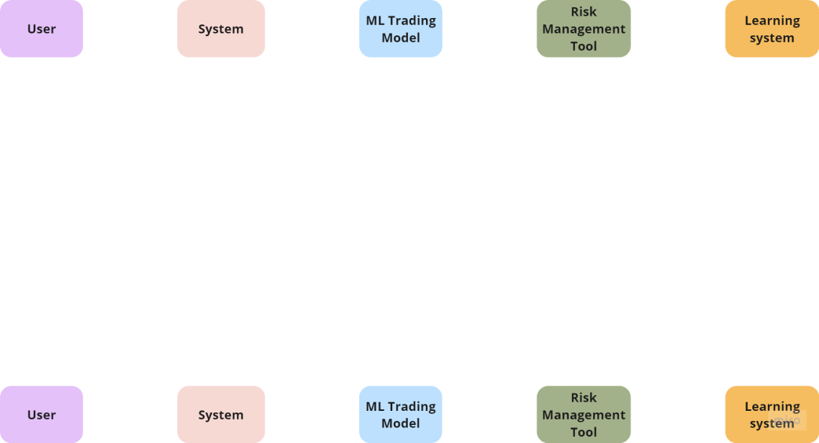
SEQUENCE DIAGRAM

Slide 21
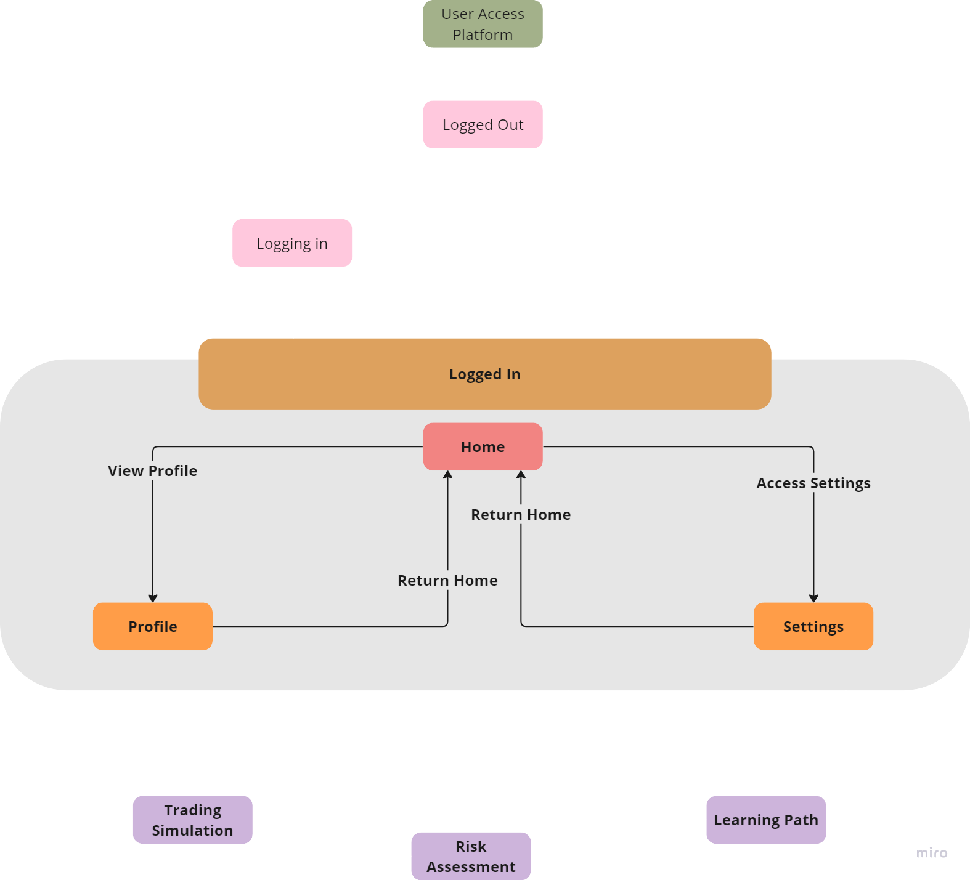
STATE DIAGRAM

Slide 22
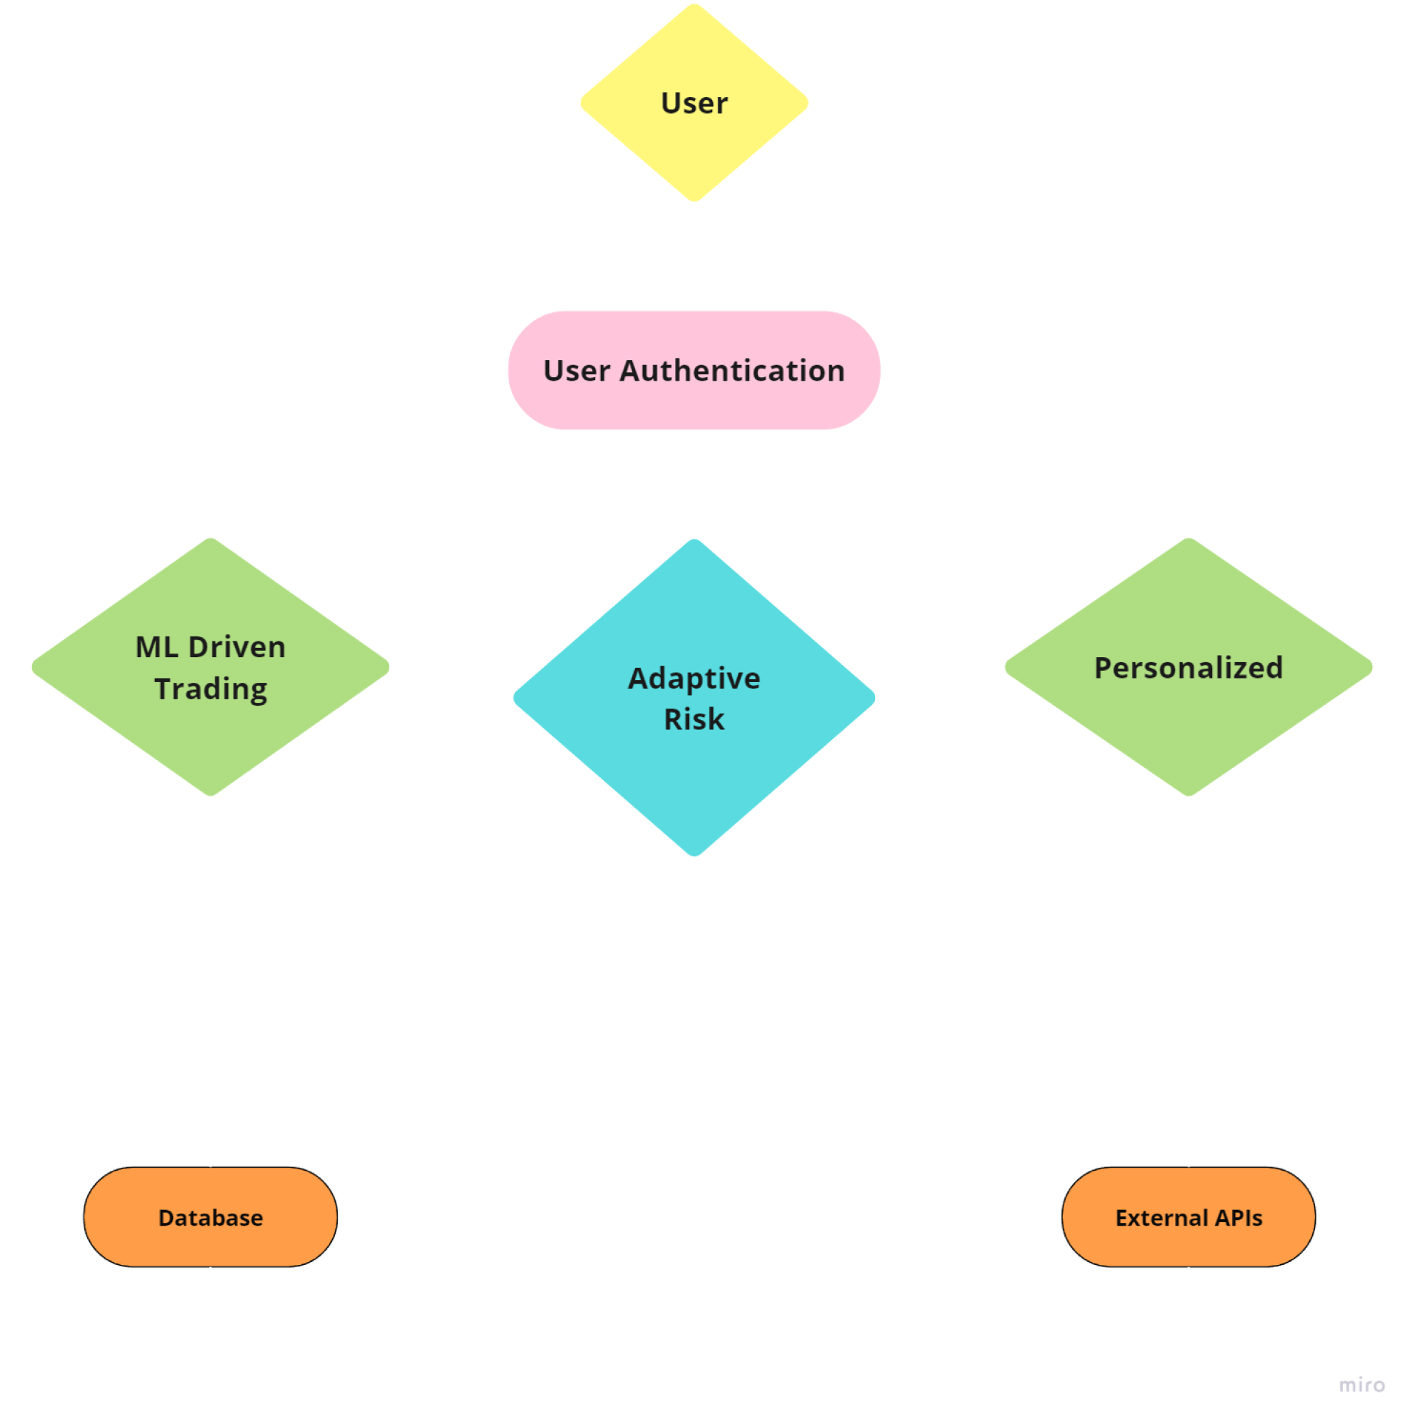
CONTEXT DIAGRAM

Slide 23
USER STORIES /ACCEPTANCE CRITERIA
Story ID | Role | Goal | Reason | Acceptance Criteria
1 | New User | Sign up and log in functionality | Access platform features | Sign up with email – Log in with email and Password reset option.
2 | User | Access to trading simulation | Learn trading risk free | G Selection of trading simulations- Feedback on trading decisions
3 | User | Risk management tools | Understand and manage trading risks | Visibility of strategy risky Suggestions for risk mitigation.
4 | User | Personalized learning paths | Enhance trading knowledge | Topic selection based on interest. Structured list of lessons and resources
5 | User | Real-time market data in simulations | Realistic trading experience | Display of live market prices. Access to historical market data.
6 | User | Secure data handling | Confidence in platform use | Secure storage of personal information. Privacy Settings management.

Slide 24
RECAP

Slide 25
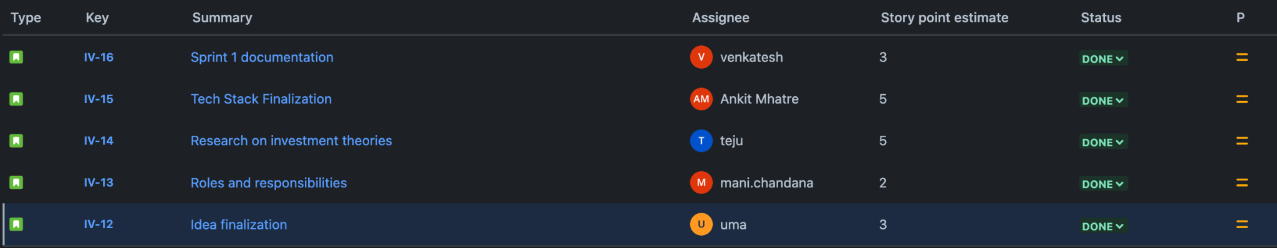

SPRINT 1
STORY

Slide 26
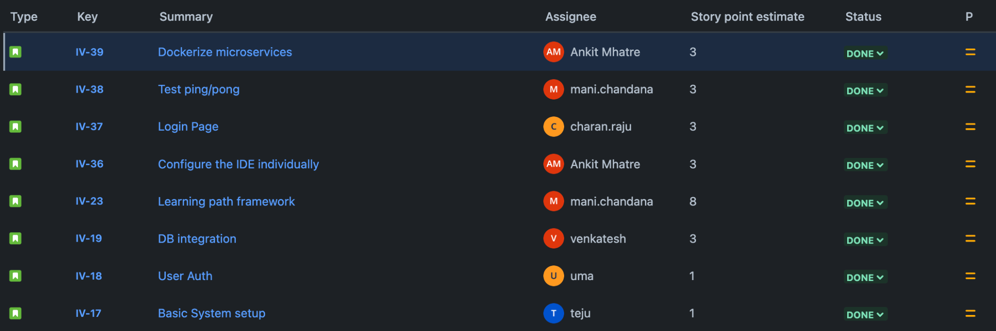
SPRINT 2
STORY

Slide 27
PRODUCT BACKLOG

Slide 28
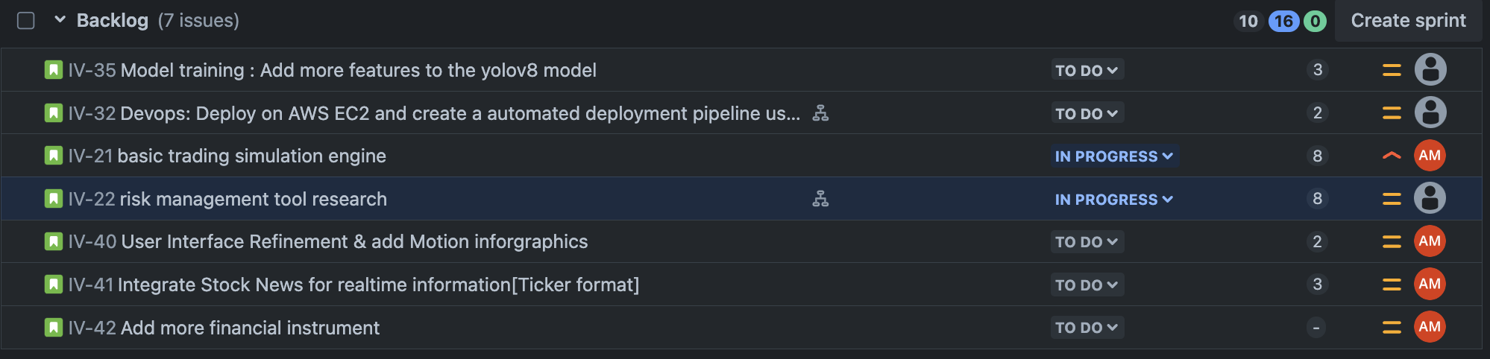
STORY

Slide 29
SPRINT 3

Slide 30
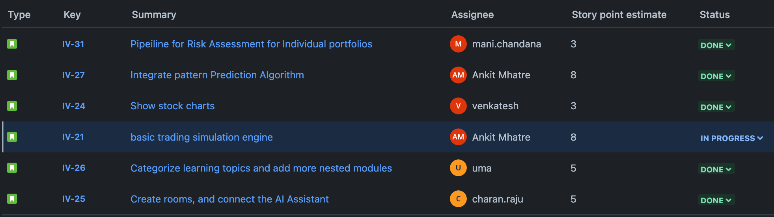
SPRINT 3 BACKLOG
STORY

Slide 31
ACCEPTANCE CRITERIA (contd.)
Sr.No | Summary | Acceptance Criteria
1 | Pipeline for Risk Assessment for Individual portfolios | Collect portfolio data Calculate risk metrics
2 | Integrate pattern Prediction Algorithm | Perform pattern prediction Allow further customisation
3 | Categorize learning topics and add more nested modules | Provide a mechanism for topic categorization Enable creation of nested modules
4 | Create rooms, and connect the AI Assistant | Allow room creation Respond to user queries Generate a screenshot on the go
5 | Show stock charts | Display Stock chart
6 | Basic trading simulation engine(building an exchange) | Place buy and sell orders View their order book Track their portfolio balance

Slide 32
TEST CASES

Slide 33
Test case | Test Steps | Expected Results | Actual Results
Login and View Tradable Assets | Launch the trading simulation platform. Enter valid login credentials. Verify that the user is successfully logged in and can see a list of tradable assets. Verify that the list includes basic information like stock ticker symbol, company name, and current price. | - User successfully logs in. - A list of tradable assets is displayed. - Each asset entry includes ticker symbol, company name, and current price. | The user successfully logs in and sees a list of tradable assets with information like ticker symbol, company name, and current price.
Place a Buy Order | Login to the platform. Choose a tradable asset from the list. Enter a valid quantity of shares to buy. (Optional) Enter a desired price per share (limit order). Submit the buy order. Verify that the order is successfully placed and reflected in the user's order book. | - Buy order is submitted successfully. - Order is reflected in the user's order book. - User's account balance is deducted for the purchase (considering fees). | The buy order is submitted successfully, reflected in the user's order book, and the user's account balance is deducted for the purchase (considering any transaction fees)
Place a Sell Order | Login to the platform. Ensure the user has a holding of the desired asset (complete a buy order beforehand if necessary). Choose the asset you want to sell from your holdings. Enter a valid quantity of shares to sell (within available holding). (Optional) Enter a desired price per share (limit order). Submit the sell order. Verify that the order is successfully placed and reflected in the user's order book. | - Sell order is submitted successfully. - Order is reflected in the user's order book. - User's portfolio reflects reduced holding and updated balance (after execution). | The sell order is submitted successfully, reflected in the user's order book, and the user's portfolio reflects the reduced holding and updated balance upon successful execution (considering any transaction fees).

Slide 34
Order Matching and Execution | Login to the platform with multiple users (or create test accounts). User A places a buy order for Asset X at a specific price. User B places a sell order for Asset X at the same price (or a lower price for a sell order). Verify that the system automatically matches these orders and executes the trade. Verify that User A's order book shows the order as filled and their portfolio reflects the purchased shares. Verify that User B's order book shows the order as filled and their portfolio reflects the reduced holding and updated balance. | - Matching orders are automatically identified. - Trade is executed successfully. - User portfolios and order books reflect the completed transaction. | Matching orders are identified, the trade is executed successfully, and both user portfolios and order books are updated to reflect the completed transaction.
Order Cancellation | Login to the platform. Place a buy or sell order for an asset. Locate the open order in the user's order book. Verify the option to cancel the order is available. Cancel the open order. Verify that the order is removed from the user's order book and is no longer listed as pending. | - User can cancel the open order. - Order is removed from the user's order book. - Order status reflects cancellation. | The user successfully cancels the open order, which is removed from their order book, and the order status reflects cancellation.
Order Validation and Error Handling | Login to the platform. Try placing an order with an invalid quantity (e.g., negative number). Verify that the system displays an error message indicating the issue. Try placing an order for a non-existent asset. Verify that the system displays an error message indicating the unavailable asset. Try placing a sell order for a quantity exceeding the user's holdings. Verify that the system displays an error message indicating insufficient funds or shares.

Slide 35
METRICS

Slide 36
TEAM VELOCITY
29 story points

Slide 37
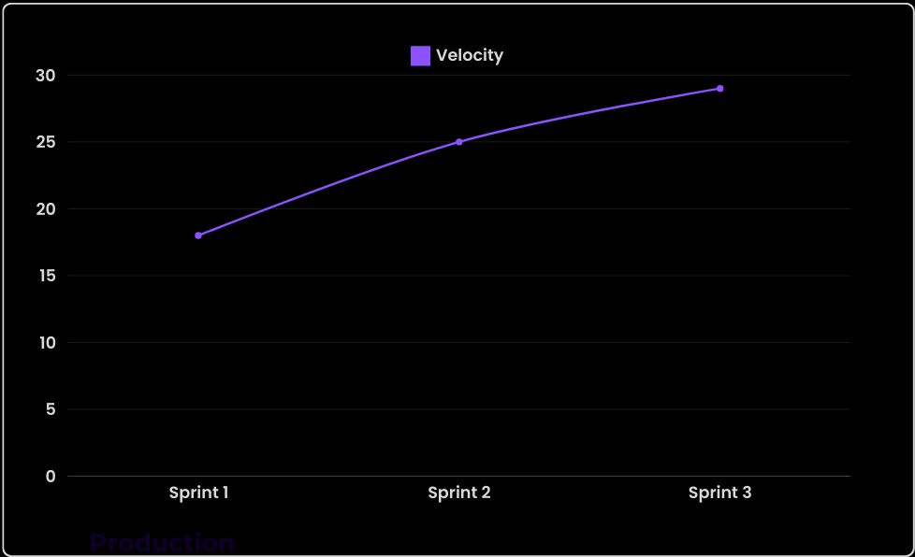
HISTORICAL VELOCITY

Slide 38
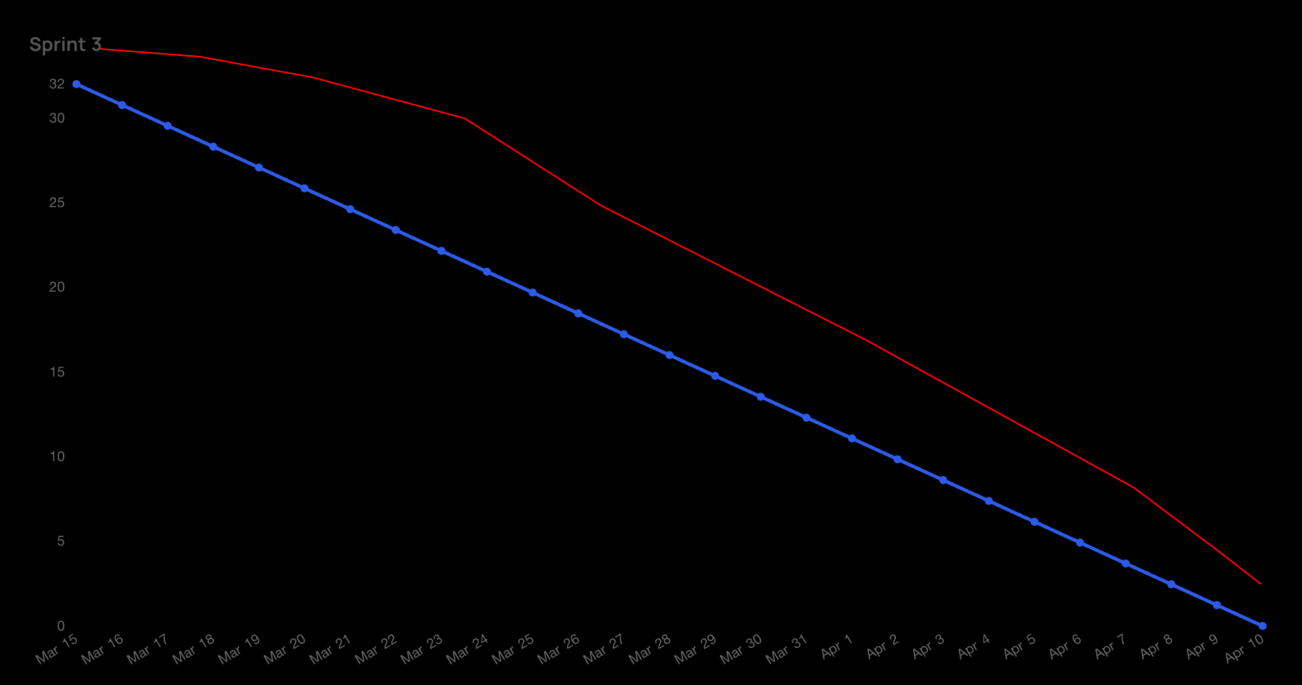
SPRINT 3, BURNDOWN CHART

Slide 39
COMPLETED/COMMITTED RATIO
90%

Slide 40
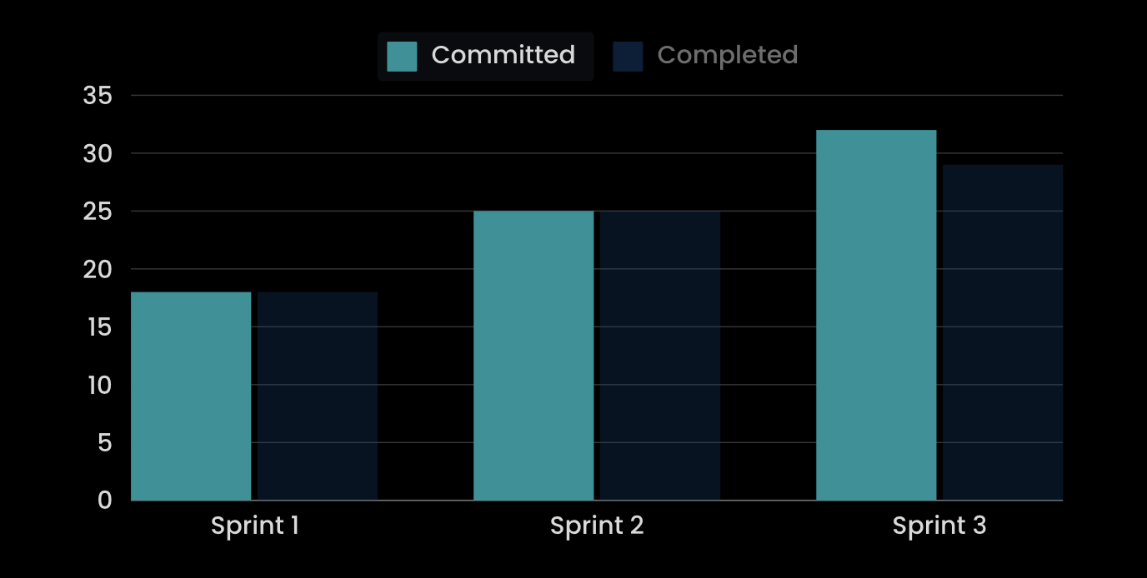
HISTORICAL COMPLETED/COMMITTED RATIO

Slide 41
RETROSPECTIVE

Slide 42
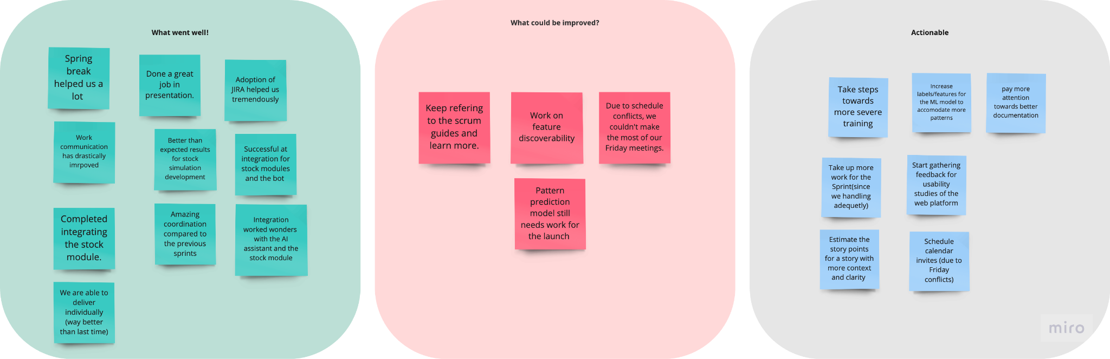
RETROSPECTIVE

Slide 43
SPRINT 4

Slide 44
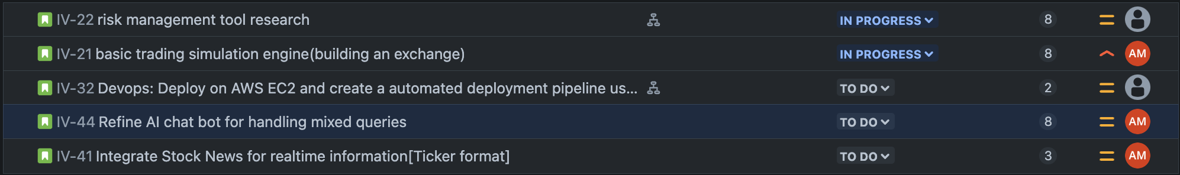
SPRINT 4

Slide 45
PROJECT DEMO

Slide 46
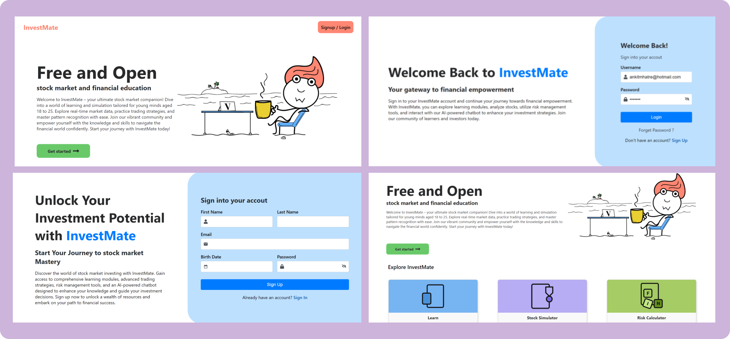

Slide 47
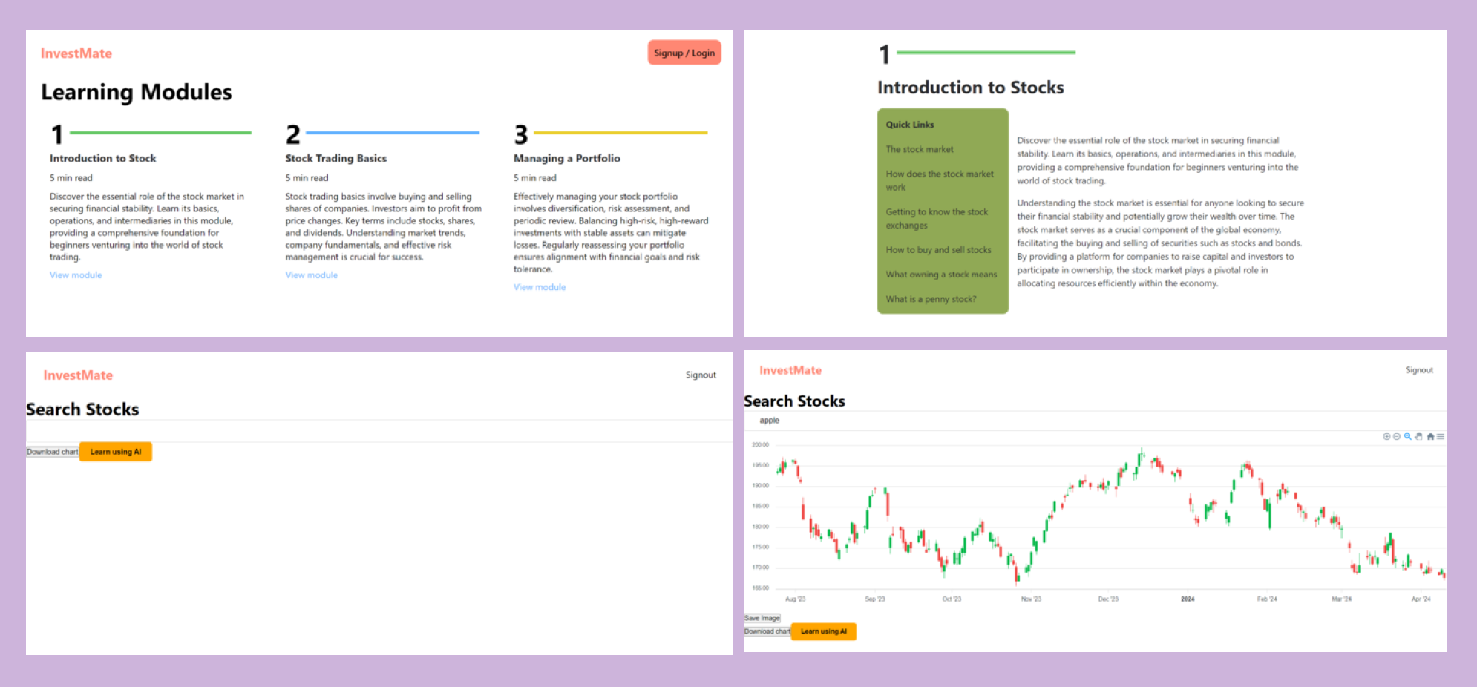

Slide 48
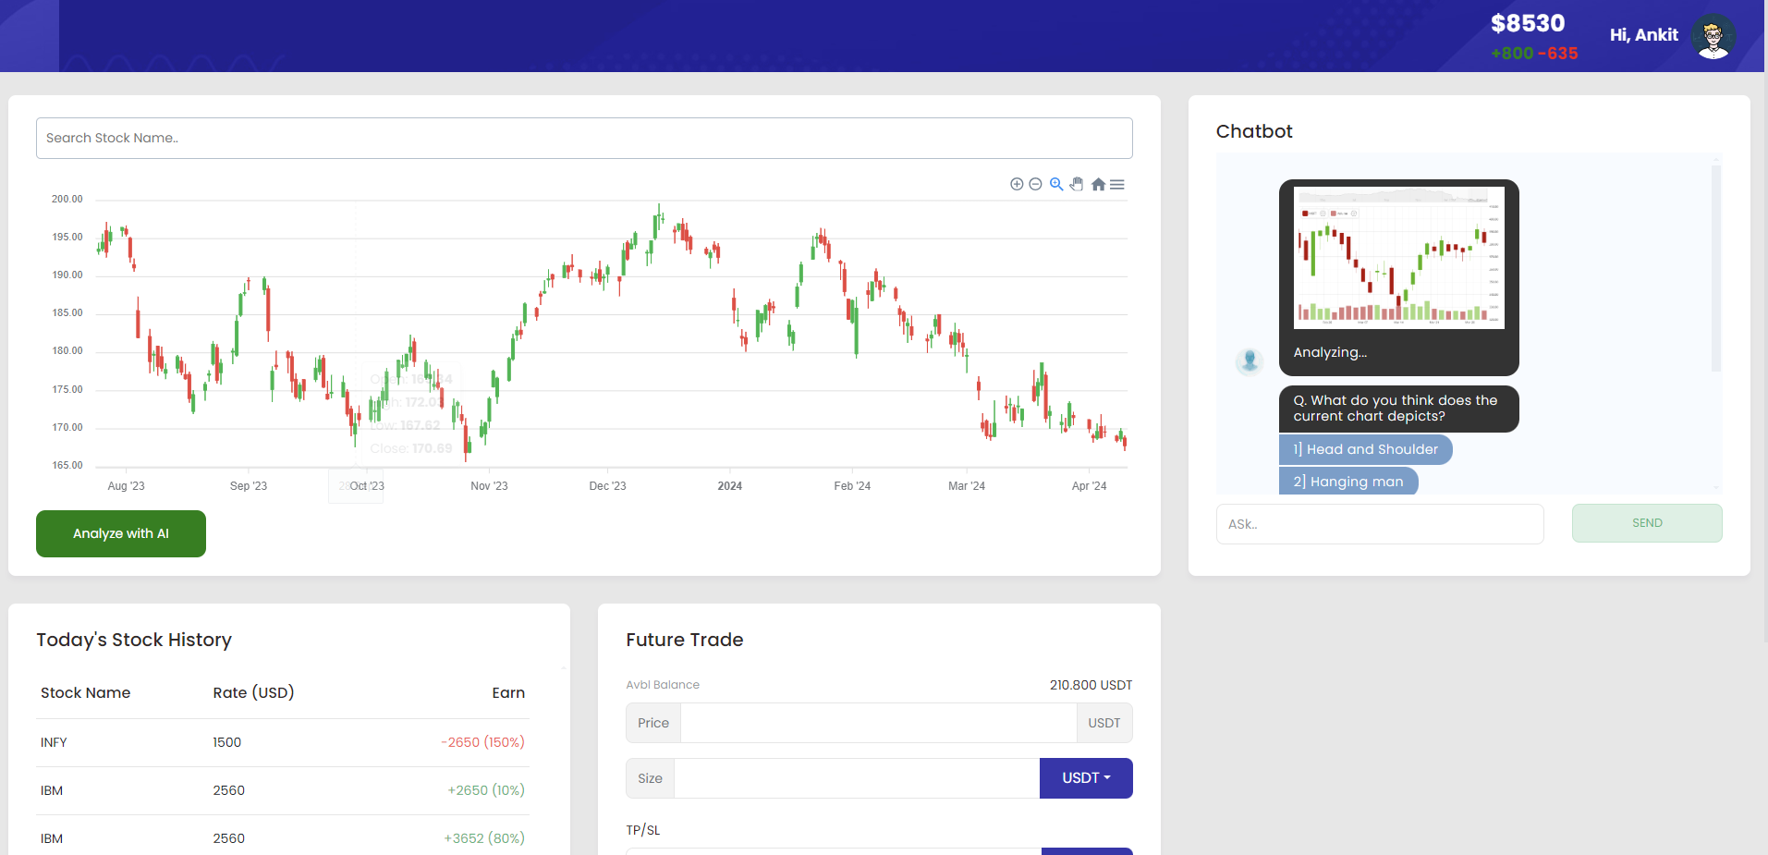

Slide 49
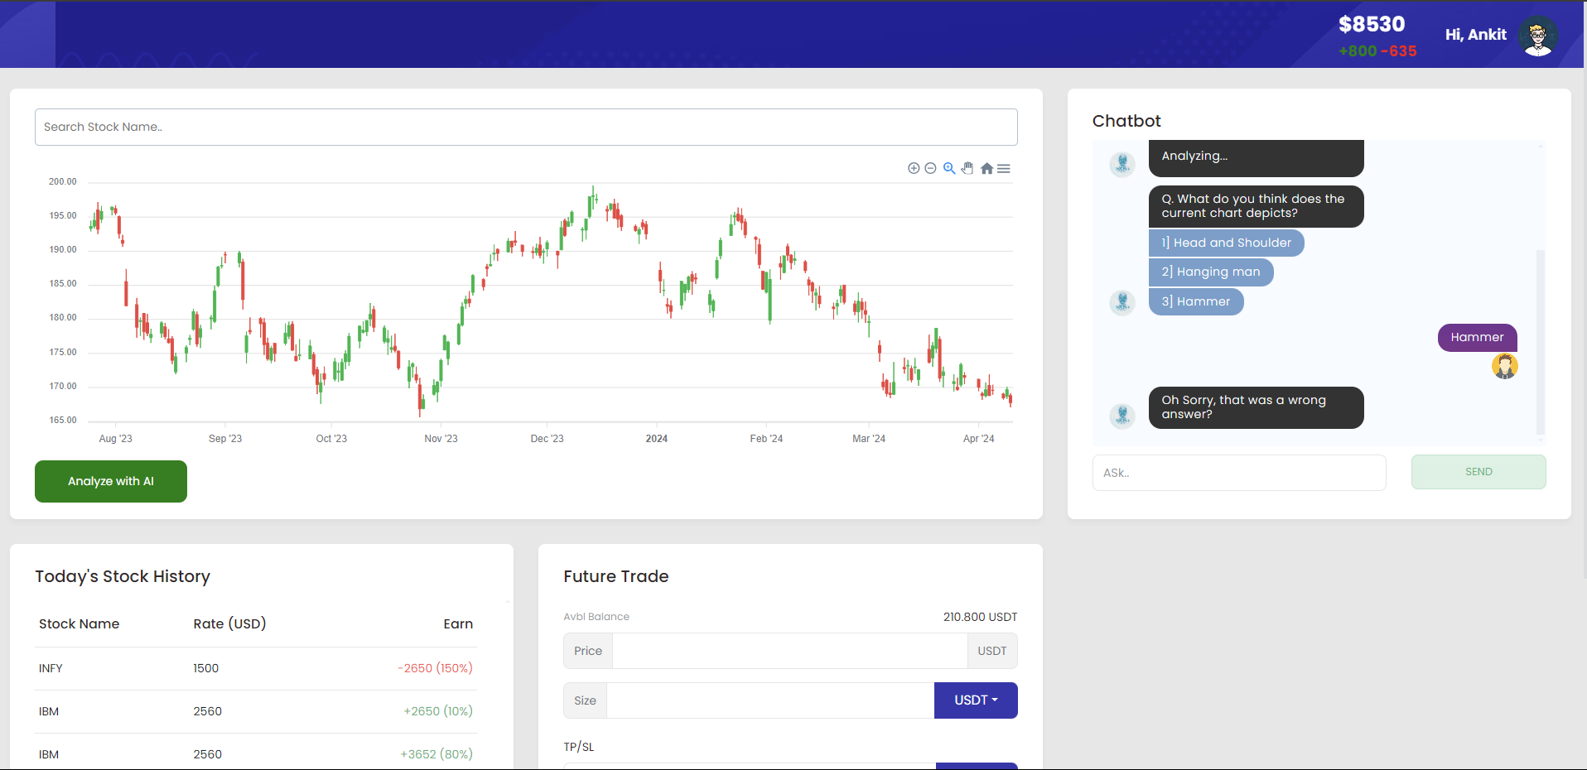

Slide 50
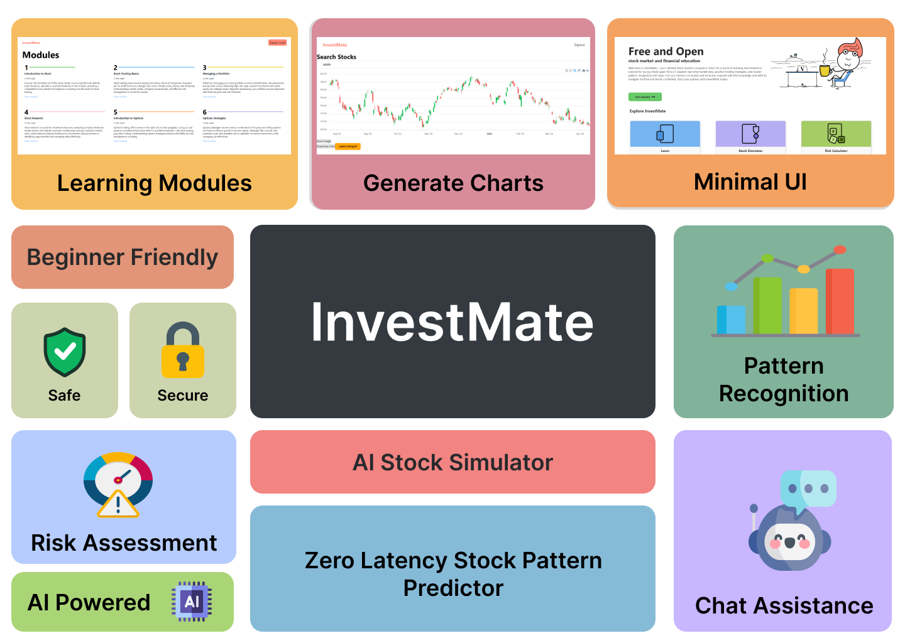

Slide 51
IMPORTANT API’s
Yahoo Finance (https://finance.yahoo.com)
Financial Modelling Prep (https://financialmodelingprep.com)
Alphavantage (https://www.alphavantage.co/)
News API (https://newsapi.org)
Apex Charts (https://apexcharts.com/)
Hugging Face (https://huggingface.co/foduucom/)
PyPi.com
NodeJS (https://nodejs.org/)
Investopedia (https://www.investopedia.com/)
Bootstrap (https://www.mdbootstrap.com/)

Slide 52
GITHUB
https://github.com/htmw/2024S-pace-super-kings

Slide 53
WIKI
https://github.com/htmw/2024S-pace-super-kings/wiki

Slide 54
REFERENCES
The Random Forest Model for Analyzing and Forecasting the US Stock Market in the
Context of Smart Finance
Learning Through Equity Trading Simulation
Conducting Financial Risk assessment

Slide 55
THANK YOU

